Slide 1
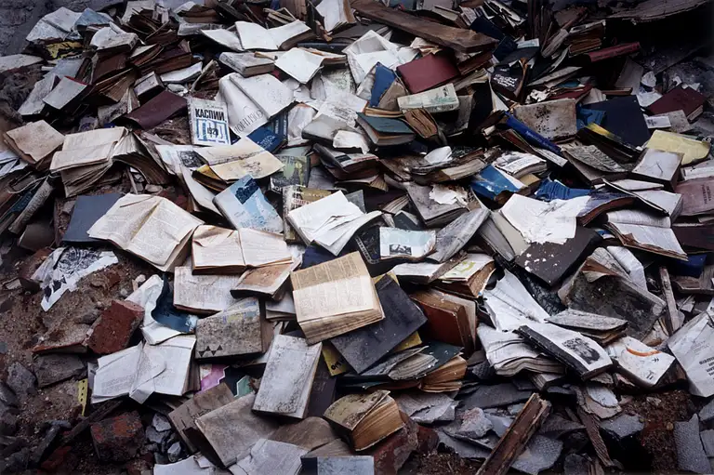
The Problem at hand
Most students in today’s world face a similar problem of Purchasing & Selling their Books. Especially in selling their used books. As the most convenient way to get rid of old books is to sell them as Wastepaper.

Slide 2

NlightN
Turn A Page, To Turn Your Life

Slide 3


Unique Selling Point
NlightN is a Business to customer & customer-to-customer Internet marketplace, providing book lovers of any background with the opportunity to buy, sell and trade books and office supplies

Slide 4
Overview
Product/Service
Multiple SKUs and an internet marketplace
Business of Operation
Limited to Lahore
Payment Method
Cash/card on Delivery
Visa/Mastercard
Jazz Cash
Business Type
Partnership

Slide 5
Vision & Mission Statement
Vision
To create a community where book lovers can connect, share, and discover books easily, while promoting literacy and knowledge-sharing.
Mission
Our mission is to offer a user-friendly online marketplace where individuals can buy and sell both new and used books. By developing a community where users can talk about books and recommend others' reading material, we hope to promote a sense of community among book enthusiasts.

Slide 6
Industry Analysis
The literacy rate of Pakistan is rising since 2018 from 58% to 62.3% in 2023 .
Relatively small-scale market

Slide 7

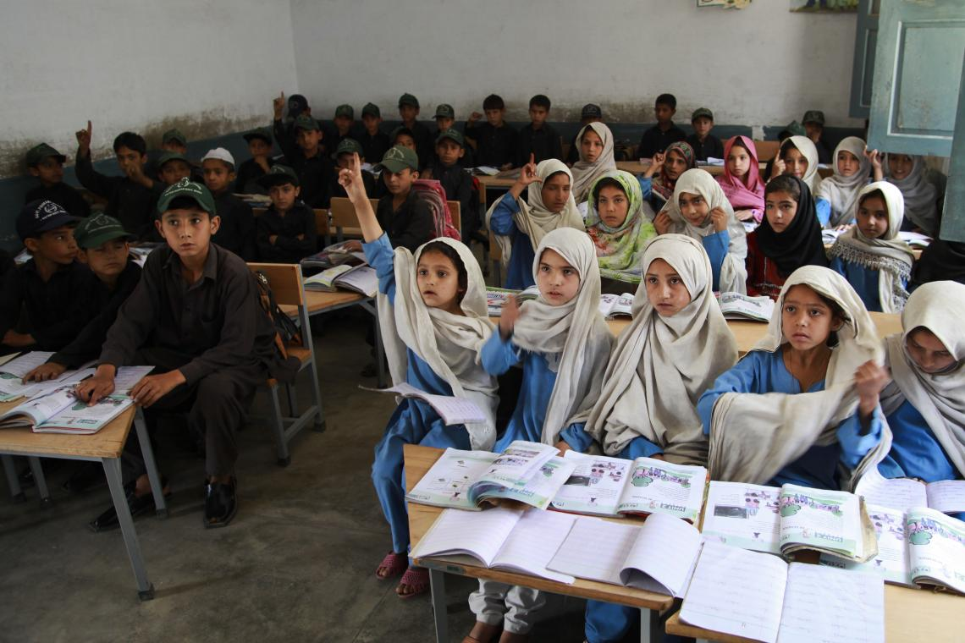

Government
Working with NGO
170,000 literacy centers
Government partnership with UNICEF
OOSC, ECE, ALP

Slide 8
Swot analysis
Strengths
Convenient for customers
Less capital
User-Friendly Interface
Weakness
Constant maintenance of website.
Cyber attacks
Reliance on Third-Party Suppliers
Opportunities
Growing E-commerce Market
Market in its infant state
Threats
Competition from established Marketplaces
Economic and Political instability
Local merchants

Slide 9



Marketing Mix
Product
Our Product is our service of an internet marketplace;
Multiple SKUs under different product lines;
Art Supplies
Paper & Notebooks
School Supplies
Writing Tools
Limited Editions
Office Supplies

Slide 10

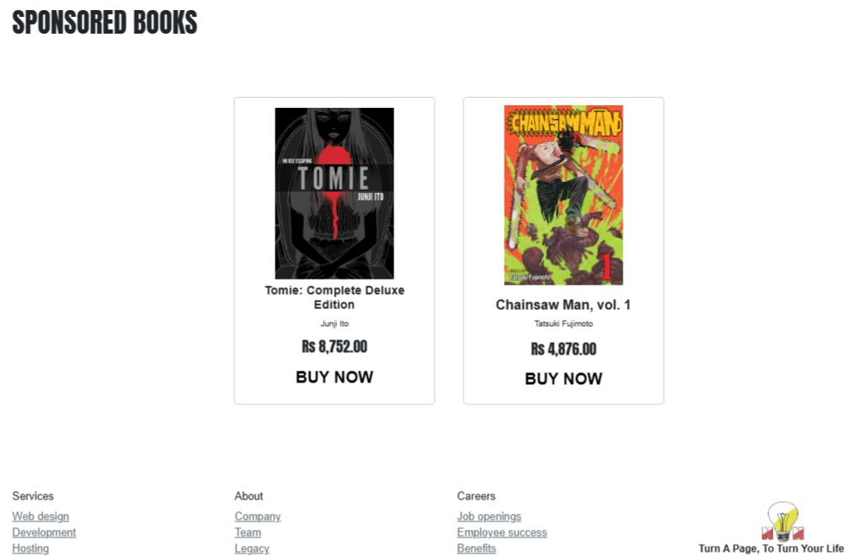
Marketing Mix
Price
C2C
B2C
Featured Listing
Sponsored Listing

Slide 11

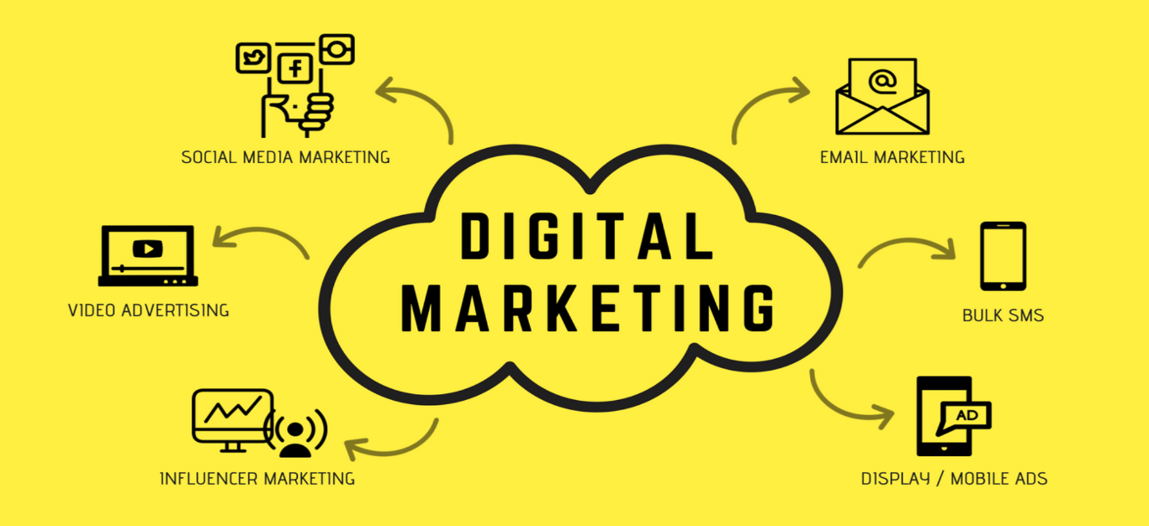
Marketing Mix
Place
Promotion
Virtual presence but limited to Lahore
Social media, email marketing, internet advertising
Influencer marketing

Slide 12
Target market
Book lovers
Students
Parents
Adults

Slide 13

Nlightn
Home Page

Slide 14
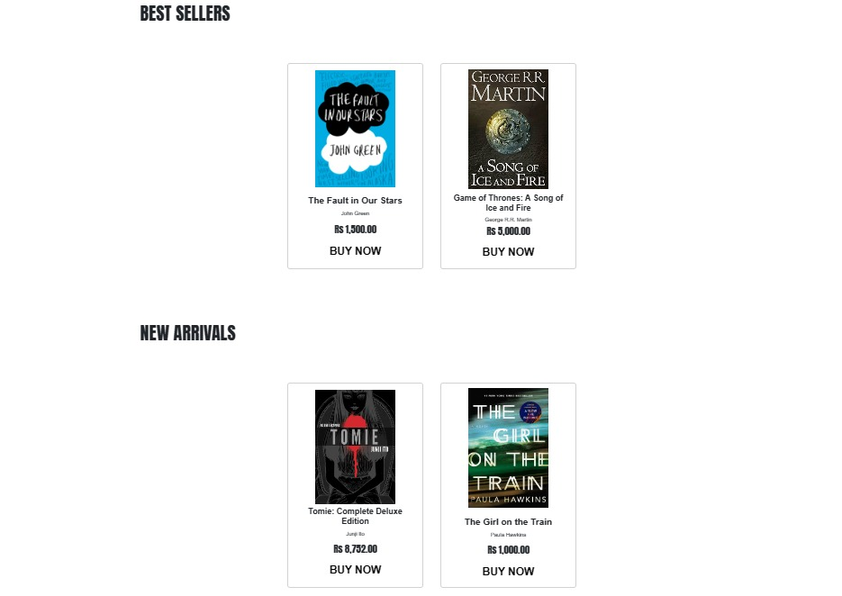
Nlightn
Home Page

Slide 15
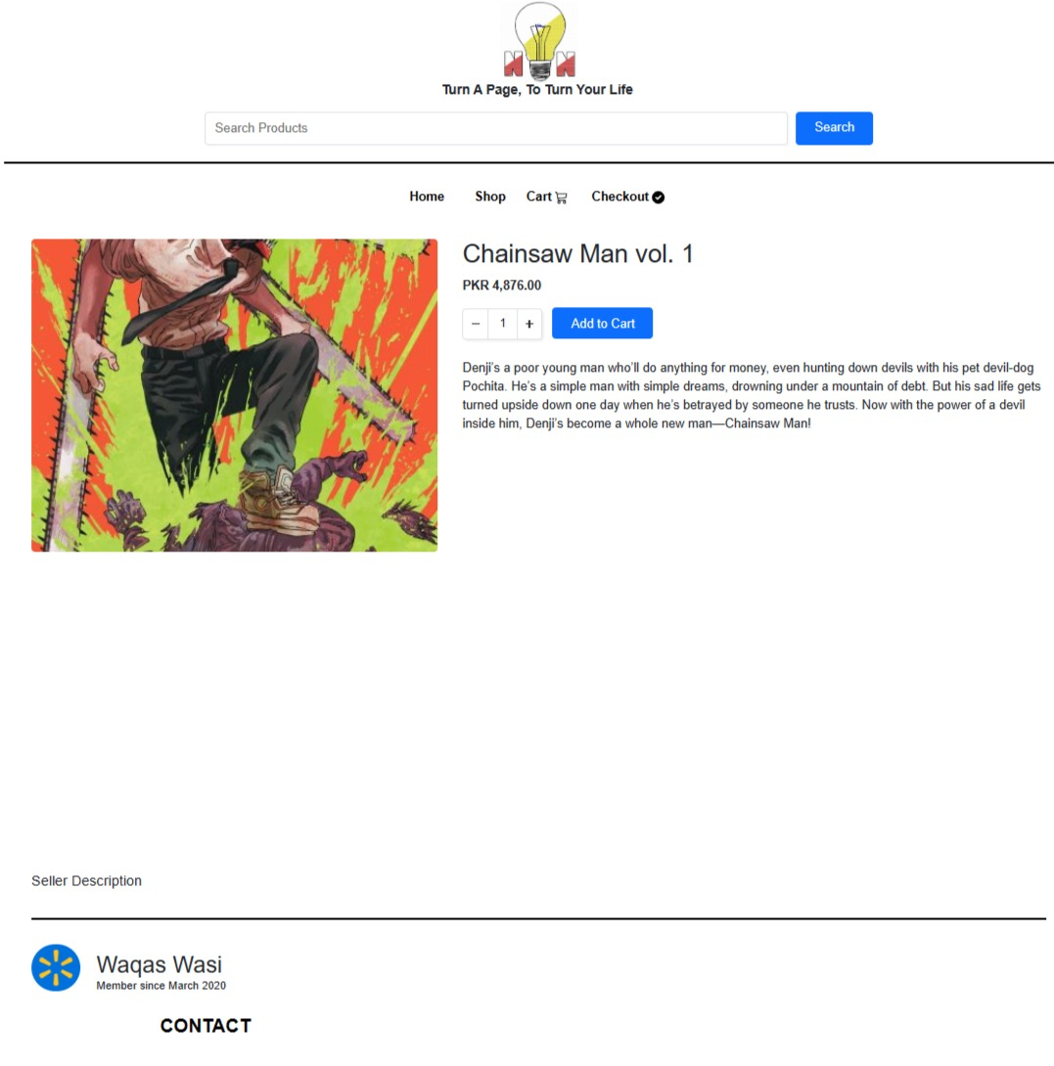
Nlightn
Book information & Seller information

Slide 16
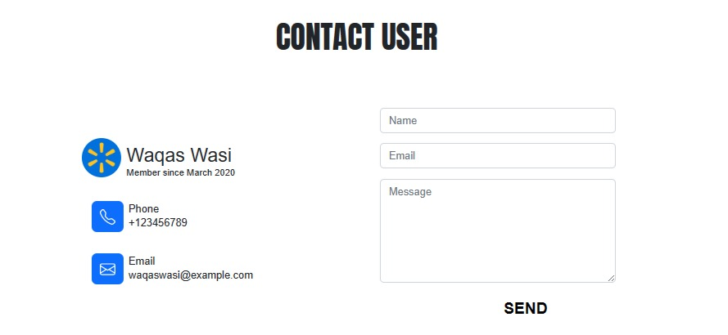
Nlightn
Seller contact information

Slide 17
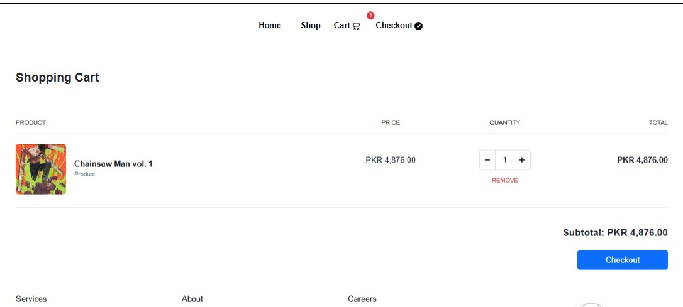
Nlightn
Checkout

Slide 18
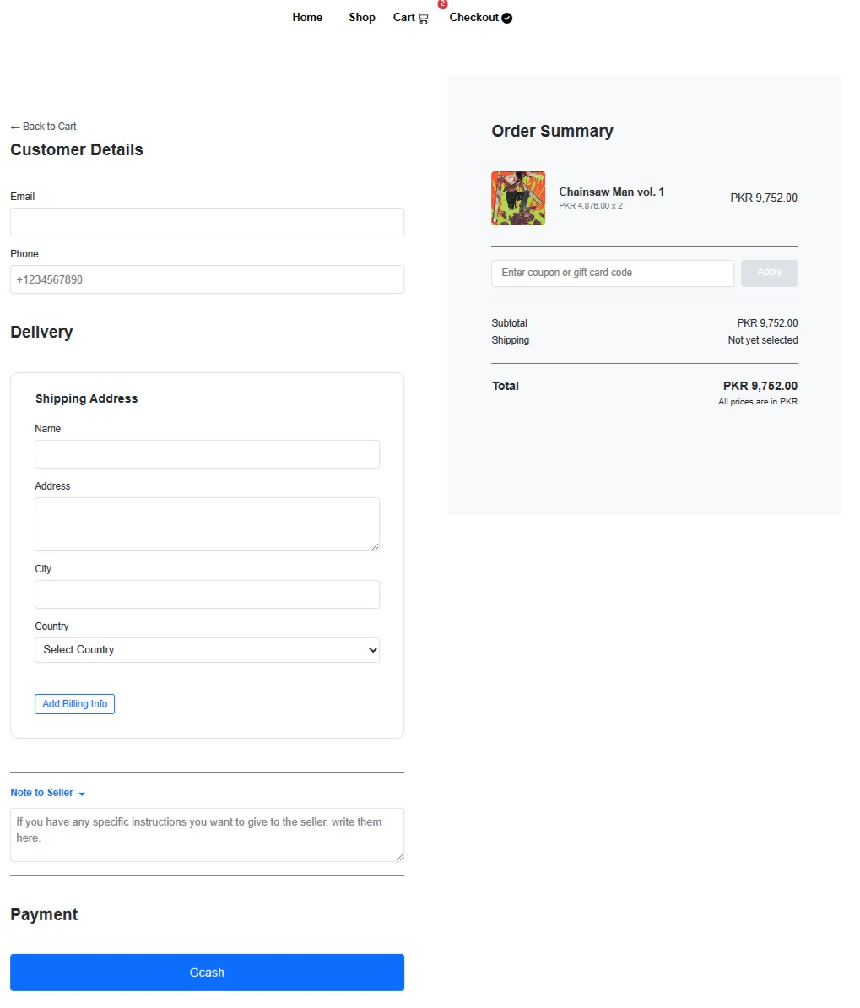
Nlightn
Payment

Slide 19
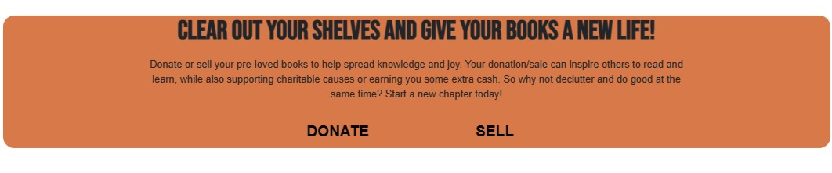
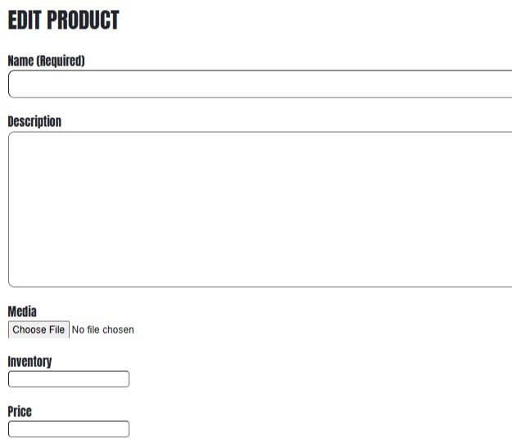
Nlightn
How to sell

Slide 20
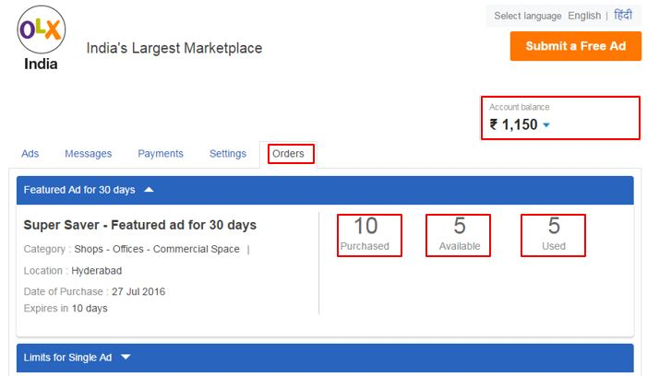
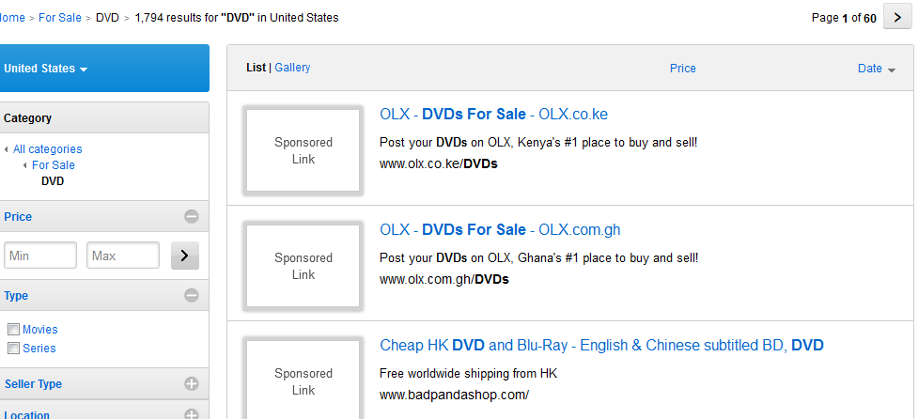
Revenue
B2C transaction
Google AdSense
Featured Listing
Sponsored Listing

Slide 21
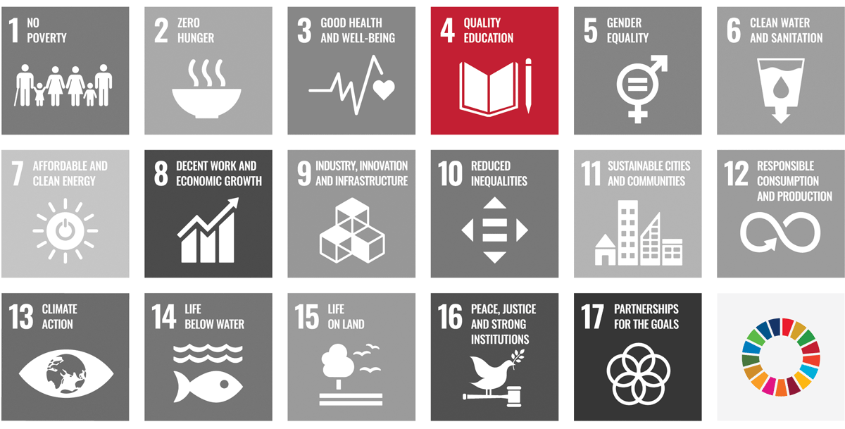
Sustainable development goals
Equitable learning opportunities
Giving back to the community
Working with NGOs

Slide 22
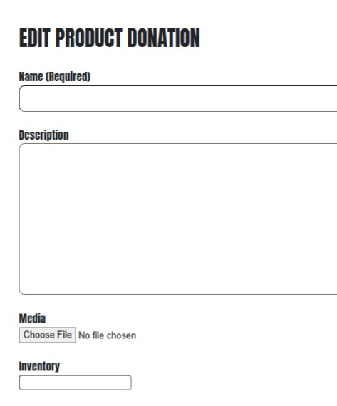
Nlightn
Donation Section

Slide 23

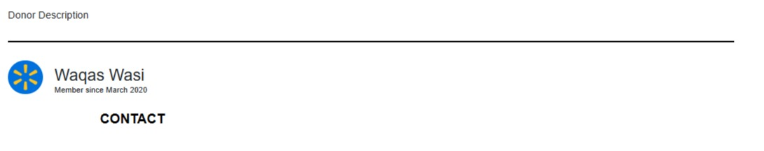
Nlightn
Donated Books

Slide 24





Competitor Analysis
LibertyBook
Kitabain
Readings
BukhariBooks
BookBerry

Slide 25
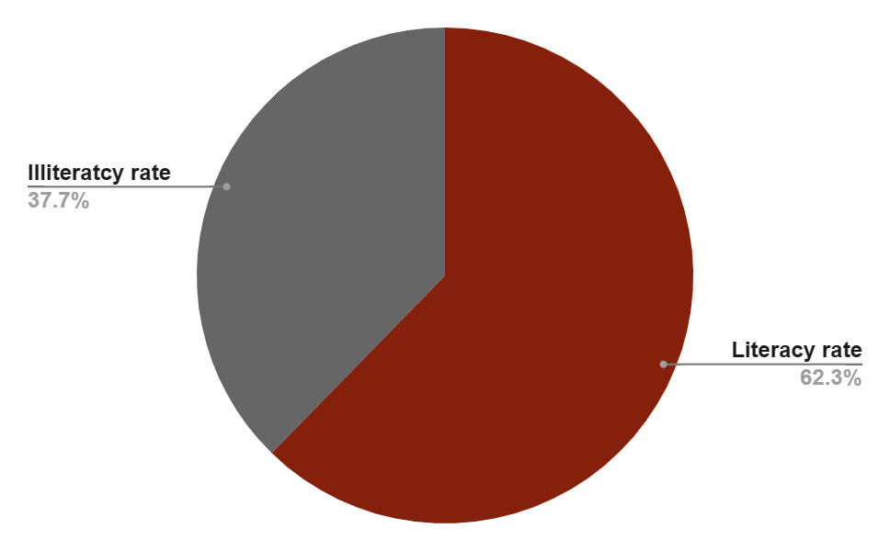
Demand Analysis
Recent study shows that Pakistan literacy rate
At 62.3%
Ministry of Federal Education and Professional Training

Slide 26

Product Rational
Label
Promotion
Tagline:
Social Media Marketing, referral marketing, influencer marketing
Turn A Page, To Turn Your Life

Slide 27
Product Rational
Products
Delivery
Art Supplies
Paper & Notebooks
School Supplies
Writing Tools
Limited Editions
For B2C we will charge a base fee of Rs. 199/=
The Standard delivery time is 3 working Days
If the order is over 3,000/= delivery will be free
For C2C transaction customers will need to meet up

Slide 28
Organizational structure
CEO: Salman Tipu
CPO: Zia Idrees
CTO: Waqas Wasi
CFO: Usama Tariq
CMO: Ejaz ul Hassan

Slide 29
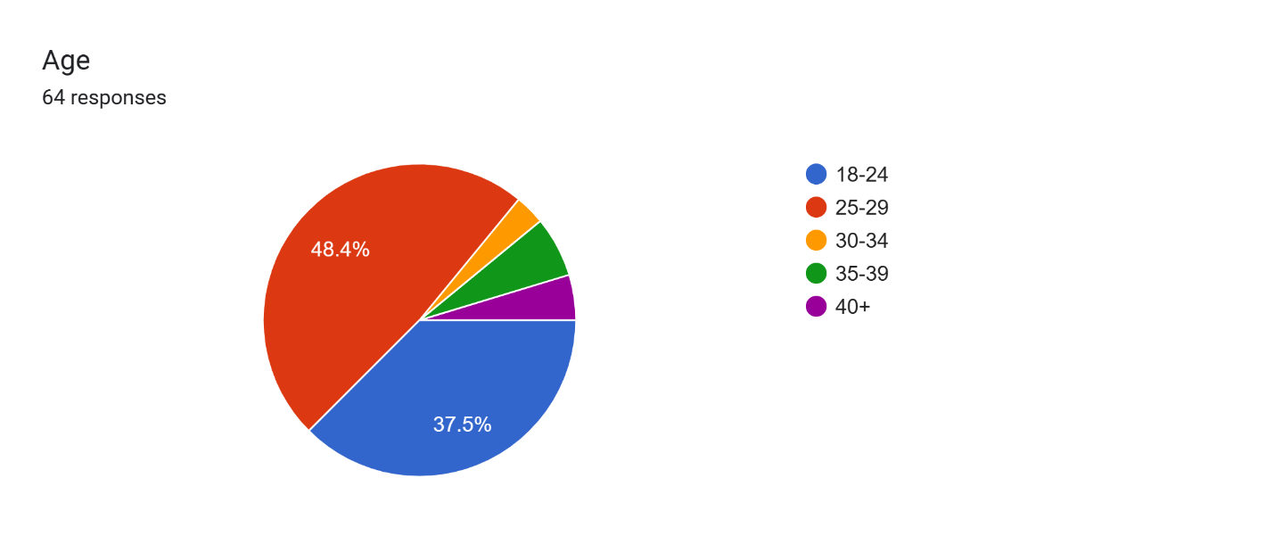
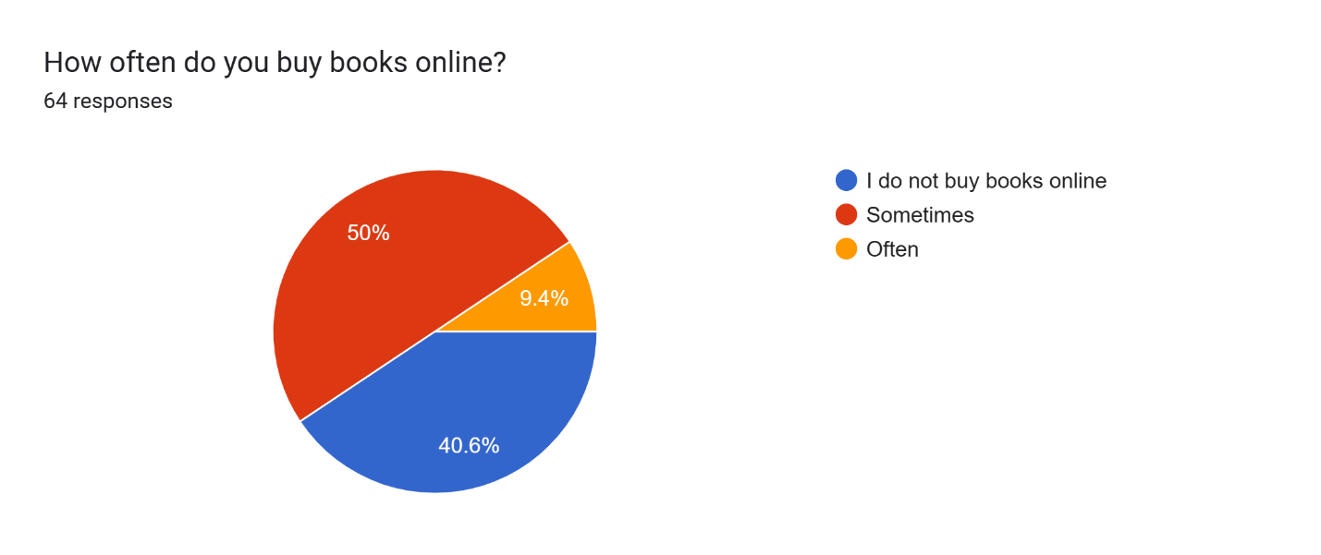
Feasibility analysis Survey

Slide 30
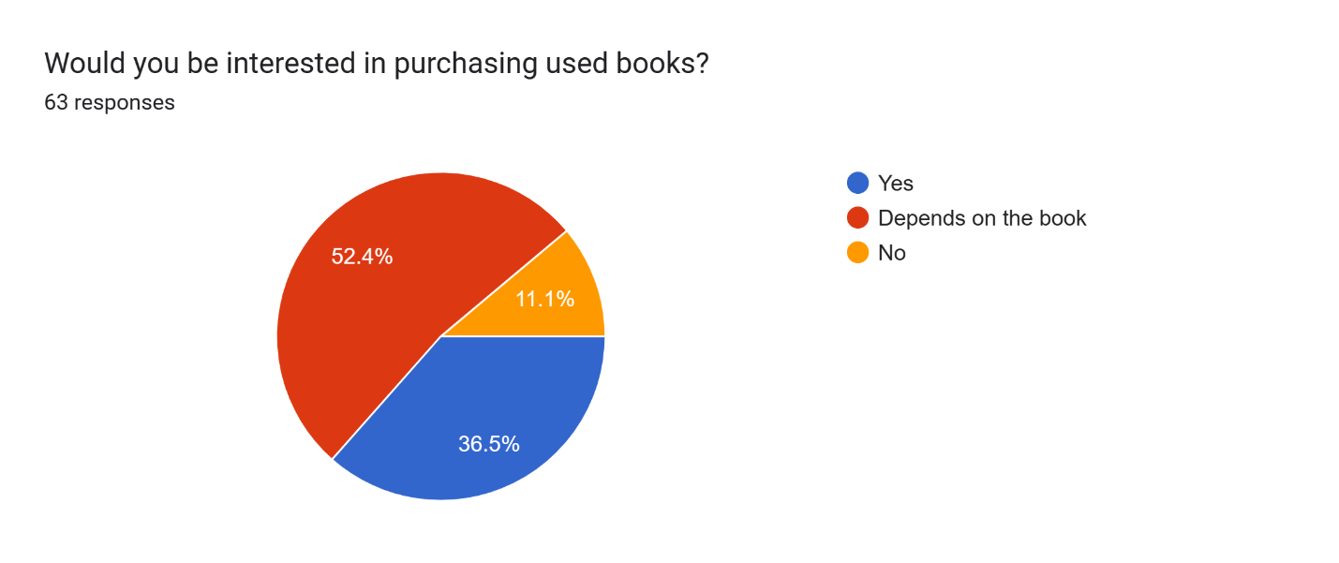
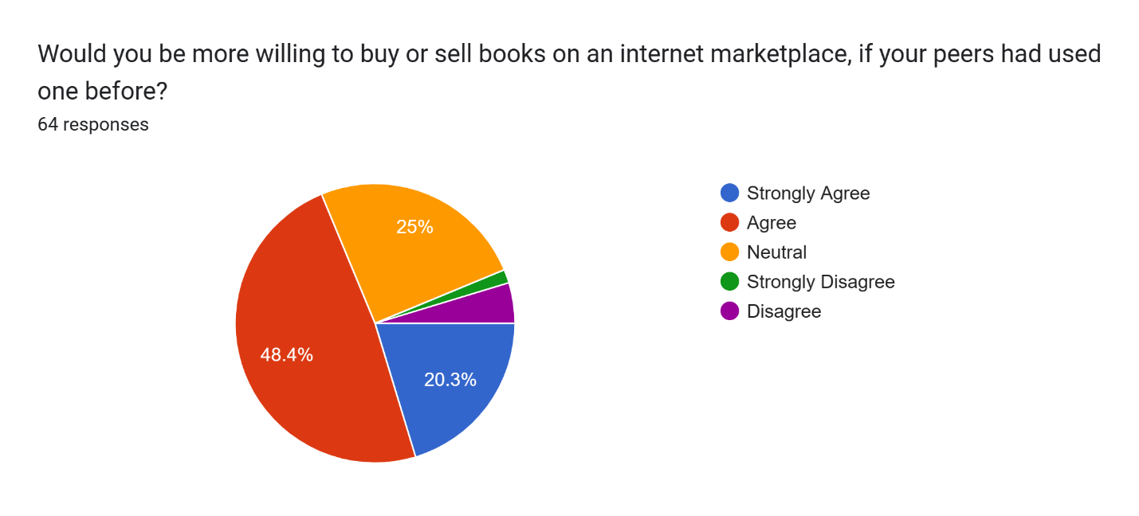
Feasibility analysis Survey

Slide 31
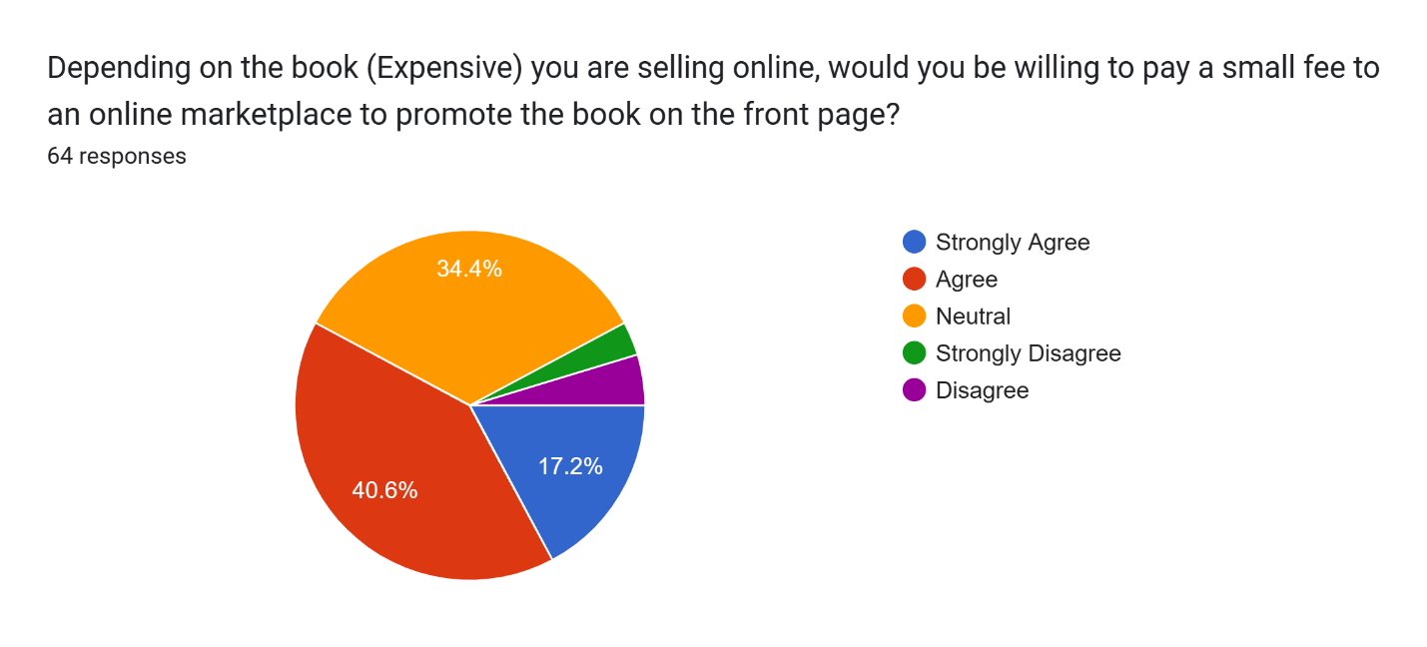
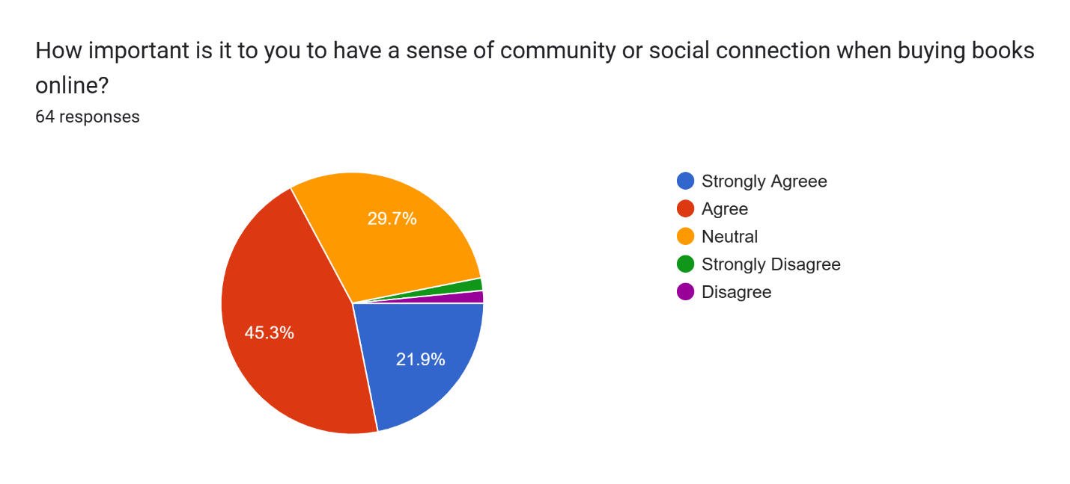
Feasibility analysis Survey

Slide 32
Business Cost
Business Cost
Equity | PKR 1,500,000.00
Business Registration | PKR 70,000.00
Website Development | PKR 150,000.00
Website Hosting | PKR 100,000.00
Inventory (SKUs) | PKR 130,000.00
Office Supplies | PKR 120,000.00
Advertisement | PKR 250,000.00
Rent Expense | PKR 250,000.00
Total Cost | PKR 1,070,000.00
Cash on hand | PKR 430,000.00
The financial plan of NlightN is based on 100% equity.

Slide 33
Income statement

Slide 34
 | 2023 | 2024 | 2025 | 2026 | 2027 | 2028
Revenue
Sales | PKR 1,600,000 | PKR 1,760,000 | PKR 1,936,000 | PKR 2,129,600 | PKR 2,342,560 | PKR 2,576,816
Cost of Goods Sold | PKR 300,000.00 | PKR 440,000.00 | PKR 484,000.00 | PKR 532,400.00 | PKR 585,640.00 | PKR 644,204.00
Gross Profit | PKR 1,300,000 | PKR 1,320,000 | PKR 1,452,000 | PKR 1,597,200 | PKR 1,756,920 | PKR 1,932,612
Operating Expenses
Salaries & Wages | PKR 500,000.00 | PKR 500,000.00 | PKR 500,000.00 | PKR 500,000.00 | PKR 500,000.00 | PKR 500,000.00
Office Expenses | PKR 20,000.00 | PKR 20,200.00 | PKR 20,402.00 | PKR 20,606.02 | PKR 20,812.08 | PKR 21,020.20
Rent Expense | PKR 100,000.00 | PKR 105,000.00 | PKR 110,250.00 | PKR 115,762.50 | PKR 121,550.63 | PKR 127,628.16
Utility Bills | PKR 100,000.00 | PKR 100,000.00 | PKR 100,000.00 | PKR 100,000.00 | PKR 100,000.00 | PKR 100,000.00
Maintenance Expenses | PKR 30,000.00 | PKR 30,000.00 | PKR 30,000.00 | PKR 30,000.00 | PKR 30,000.00 | PKR 30,000.00
Advertising Expenses | PKR 400,000.00 | PKR 400,000.00 | PKR 400,000.00 | PKR 400,000.00 | PKR 400,000.00 | PKR 400,000.00
Depreciation | PKR 10,000.00 | PKR 10,000.00 | PKR 10,000.00 | PKR 10,000.00 | PKR 10,000.00 | PKR 10,000.00
Total Operating Expenses | PKR 1,160,000 | PKR 1,165,200 | PKR 1,170,652 | PKR 1,176,368 | PKR 1,182,362 | PKR 1,188,648
Income From Operations | PKR 140,000.00 | PKR 154,800.00 | PKR 281,348.00 | PKR 420,831.48 | PKR 574,557.29 | PKR 743,963.64
Income Tax Expense
Net Income | PKR 140,000.00 | PKR 154,800.00 | PKR 281,348.00 | PKR 420,831.48 | PKR 574,557.29 | PKR 743,963.64
increase in office expense every year.

Slide 35
Balance sheet

Slide 36
 | 2023 | 2024 | 2025 | 2026 | 2027 | 2028
Current Assets
Cash | PKR 175,000.00 | PKR 192,500.00 | PKR 211,750.00 | PKR 232,925.00 | PKR 256,217.50 | PKR 281,839.25
Inventory | PKR 150,000.00 | PKR 165,000.00 | PKR 181,500.00 | PKR 199,650.00 | PKR 219,615.00 | PKR 241,576.50
Other Current Assets | PKR 50,000.00 | PKR 50,000.00 | PKR 50,000.00 | PKR 50,000.00 | PKR 50,000.00 | PKR 50,000.00
Total Current Assets | PKR 375,000.00 | PKR 407,500.00 | PKR 443,250.00 | PKR 482,575.00 | PKR 525,832.50 | PKR 573,415.75
Long-term Assets
PPE | PKR 250,000.00 | PKR 237,500.00 | PKR 225,000.00 | PKR 212,500.00 | PKR 200,000.00 | PKR 187,500.00
Depreciation | PKR 12,500.00 | PKR 12,500.00 | PKR 12,500.00 | PKR 12,500.00 | PKR 12,500.00 | PKR 12,500.00
Total Long-term Assets | PKR 250,000.00 | PKR 237,500.00 | PKR 225,000.00 | PKR 212,500.00 | PKR 200,000.00 | PKR 187,500.00
Total Assets | PKR 625,000.00 | PKR 645,000.00 | PKR 668,250.00 | PKR 695,075.00 | PKR 725,832.50 | PKR 760,915.75
Liabilities and Capital | PKR 2,023.00 | PKR 2,024.00 | PKR 2,025.00 | PKR 2,026.00 | PKR 2,027.00 | PKR 2,028.00
Current Liabilities
Accounts Payable | PKR 125,904.00 | PKR 138,494.40 | PKR 152,343.84 | PKR 167,578.22 | PKR 184,336.05 | PKR 202,769.65
Current Borrowing | PKR 100,000.00 | PKR 110,000.00 | PKR 121,000.00 | PKR 133,100.00 | PKR 146,410.00 | PKR 161,051.00
Subtotal Current Liabilities | PKR 225,904.00 | PKR 248,494.40 | PKR 273,343.84 | PKR 300,678.22 | PKR 330,746.05 | PKR 363,820.65
Long-term Liabilities | PKR 125,000.00 | PKR 137,500.00 | PKR 151,250.00 | PKR 166,375.00 | PKR 183,012.50 | PKR 201,313.75
Total Liabilities | PKR 350,904.00 | PKR 385,994.40 | PKR 424,593.84 | PKR 467,053.22 | PKR 513,758.55 | PKR 565,134.40
capital | PKR 274,096.00 | PKR 259,006.00 | PKR 243,656.00 | PKR 228,022.00 | PKR 212,074.00 | PKR 195,781.00
Total Liabilities and capital | PKR 625,000.00 | PKR 645,000.40 | PKR 668,249.84 | PKR 695,075.22 | PKR 725,832.55 | PKR 760,915.40

Slide 37
Cash flows
 | 2023 | 2024 | 2025 | 2026 | 2027 | 2028
Cashflows
Operating Profit | PKR 140,000.00 | PKR 154,800.00 | PKR 281,348.00 | PKR 420,831.48 | PKR 574,557.29 | PKR 743,963.64
Non-Cash Adjustments
Depreciation | PKR 10,000.00 | PKR 10,000.00 | PKR 10,000.00 | PKR 10,000.00 | PKR 10,000.00 | PKR 10,000.00
Provision for doubtful debt | PKR 20,000.00 | PKR 20,000.00 | PKR 20,000.00 | PKR 20,000.00 | PKR 20,000.00 | PKR 20,000.00
Changes working capital changes | PKR - | PKR (9,909.60) | PKR (10,900.56) | PKR (11,990.62) | PKR (13,189.68) | PKR (14,508.65)
Cash Generated | PKR 170,000.00 | PKR 174,890.40 | PKR 300,447.44 | PKR 438,840.8 | PKR 591,367.62 | PKR 759,455.00

Slide 38
Future Goals
Acquire 1,000 registered users in the first year
Increase website traffic by 30% in the first six months
Increase sales revenue by 20%
Next year we want to increase the number of registered users by 30% per quarter
Establish partnerships with at least five book publishers or authors in the first year.

Slide 39
Thanks For Your Consideration.

